Slide 1
CHAPTER 1
Basic concepts and terminology
In this chapter we will briefly review some basic and terminology that we shall make use of throughout this book. We will start by examining the notion of the UNIX file.
Prof. Ju-Hong Lee, Data Science Lab, Inha Univ

Slide 2
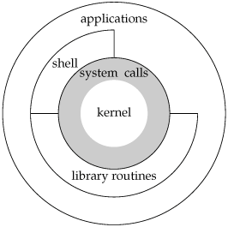
UNIX Structure

Slide 3
Logging In (1/2)
Login Name
When we log in to Unix system we enter our login name
Followed by our password
/etc/passwd

Slide 4
Logging In (2/2)
Shells
Once we log in, we able to enter commands to the shell
Command line interpreter (user input and execute command)
Bourn shell(/bin/sh) : $
KornShell(/bin/ksh) : $
C shell(/bin/csh) : %

Slide 5
File and Directories (1/2)
Filesystem
Unix filesystem is a hierarchical arrangement of directories and files.
Everything starts in the directory called root whose name is the single character /.
A directory is a file that contains directory entries. (directory entry contains i-node and file name)
Filename
Characters that cannot appear in a filename
‘/’, null character
Two filenames are automatically created whenever a new directory is created: ‘.’, ’..’
. : current directory
.. : parent directory

Slide 6
File and Directories (2/2)
/
Pathname
Absolute pathname : /usr/keith/file1
Relative pathname : keith/file1
Working Directory
Every process has a working directory (sometimes called the current working directory)
This is the directory from which all relative pathnames are interpreted.
% pwd (print working directory)
Home Directory
When we log in, the working directory is set to our home directory (/etc/passwd)
% cd ~
usr
keith
ben
file1
file2

Slide 7
Generalization of the file concept
UNIX extends the file concept to cover not only normal file (regular files in UNIX terminology) but also peripheral device and inter-process communication channels.
All I/O devices are represented as files:
/dev/stdin, /dev/stdout, /dev/rmt0
$ cat file > /dev/rmt0
Inter-Process Communication channels as a file:
FIFO, PIPE, SOCKET

Slide 8
Unix File Types (1/2)
Regular file
Binary or text file
Unix does not know the difference!
Directory file
A file that contains the names and locations of other files.
Character special and block special files
Terminals (character special) and disks (block special)
FIFO (named pipe)
A file type used for interprocess communication
Socket
A file type used for network communication between processes

Slide 9
Ownership and Permissions
Ownership
Each file is owned by a particular user
Owner can choose the permission associated with a file.
Permissions
Control who can access the file and what way
Ownership bestows certain rights, one of which is the ability to change another type of file attribute, namely permissions

Slide 10
Unix File Types (2/2)
d : directory
l : symbolic link
b : block special file
c : character special file
p : FIFO
-: regular file

Slide 11
Process
Process
Instance of an executing program.
$ ls
$ ps (display information about processes)
Inter-process communication (IPC)
Pipe
FIFO
Signals
Shared memory
Semaphore
Sockets (used for cooperating process across a network)

Slide 12
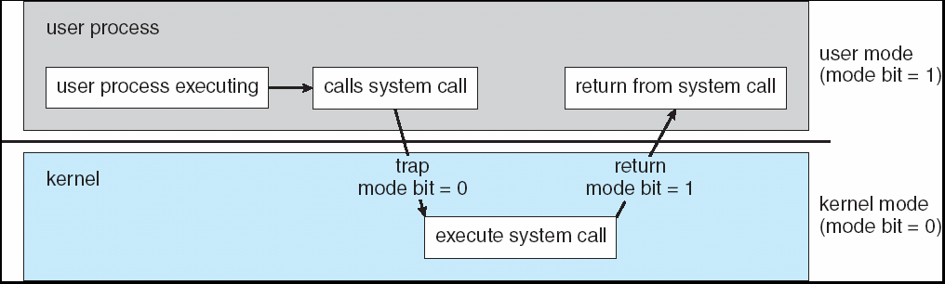
System calls and library subroutines(1/2)
System call
Software developer’s passport into the UNIX kernel
Programmer would call an ordinary C subroutine or function.
The real work done inside the kernel.
nread = fread(inputbuf, OBJSIZE, numberobjs, fileptr);
nread = read(filedes, inputbuf, BUFSIZE);
User space
Program
code
Library routine fread
read
User code
read Kernel code
Kernel space

Slide 13
System calls and library subroutines(2/2)
System call involves two context switches(from user to kernel and back)
It takes much longer than a simple function call within a process’s own address space.
So it’s a good idea to avoid excessive system calls.
Every system call is defined in a header file.
You have to ensure that you’ve included the correct headers before you make the call.
Tip!. There’s no harm in including a header you don’t actually need, so it’s easiest to collect the most common headers into a master header and just include that.

